Slide 1

Applying Recurrent Neural Networks to Predict Forex Prices: High-Frequency Directional Trading Approach
Masixole Boya | Supervised by Dr. Martins Arasomwan
University of the Witwatersrand, Johannesburg

Slide 2
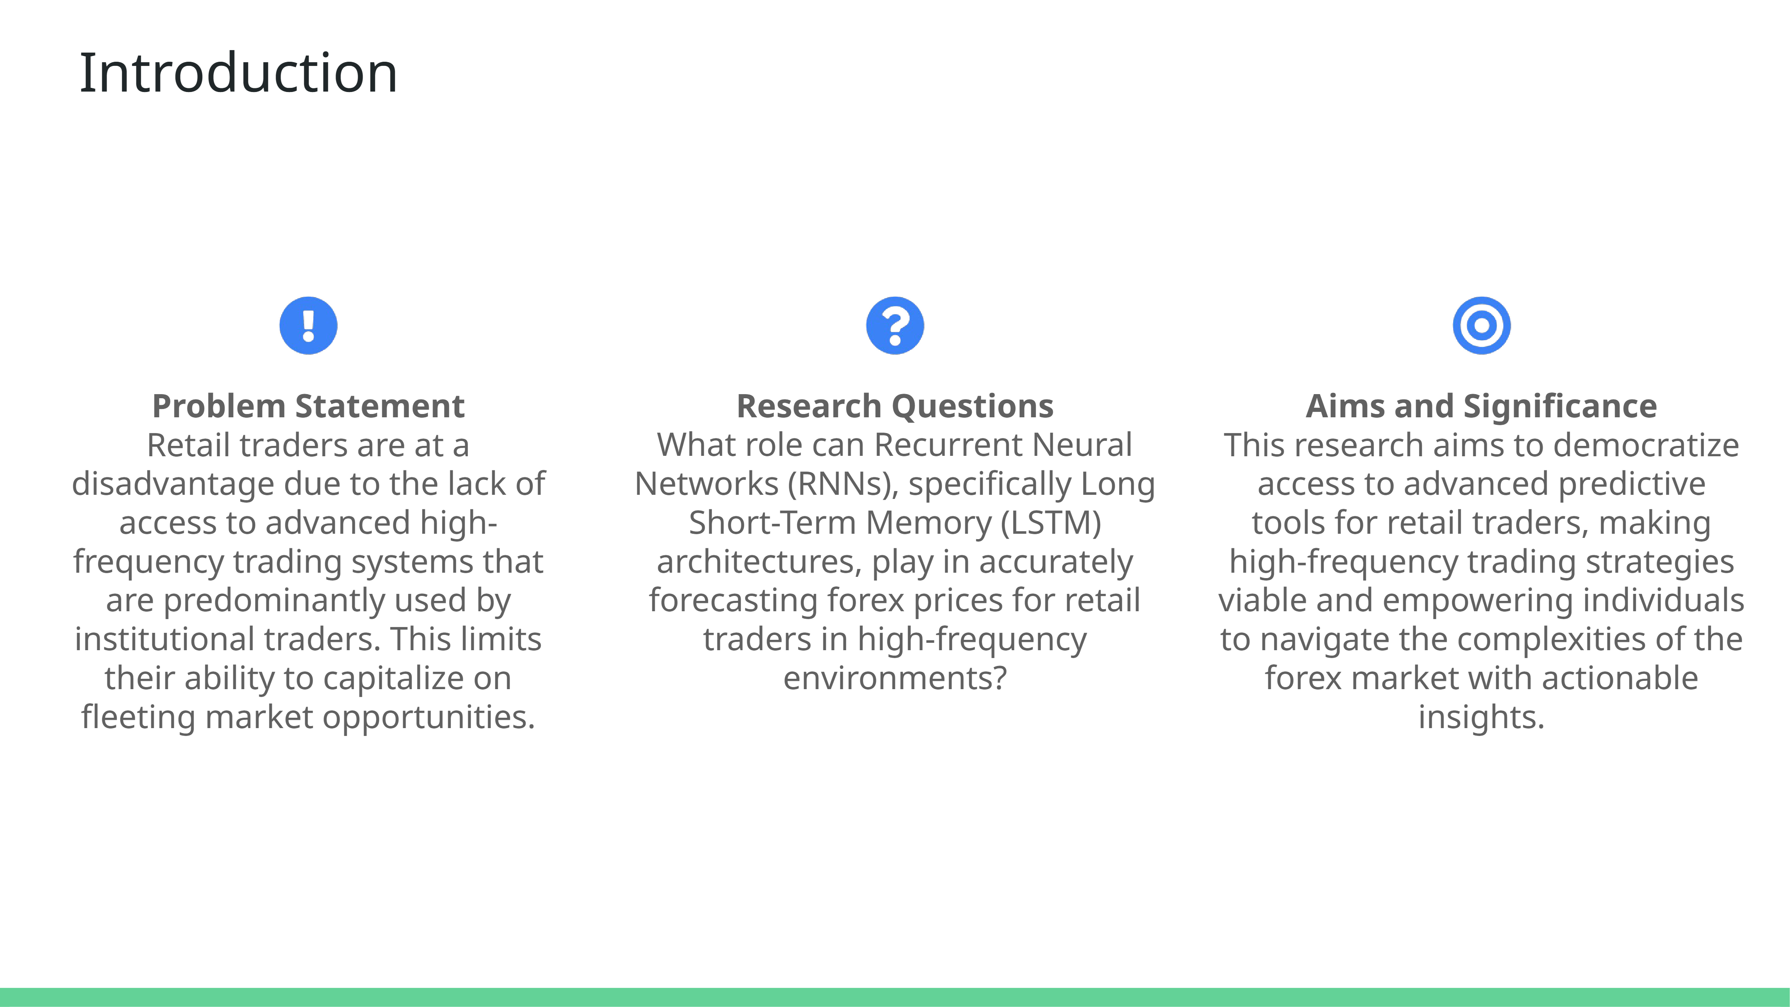

Slide 3
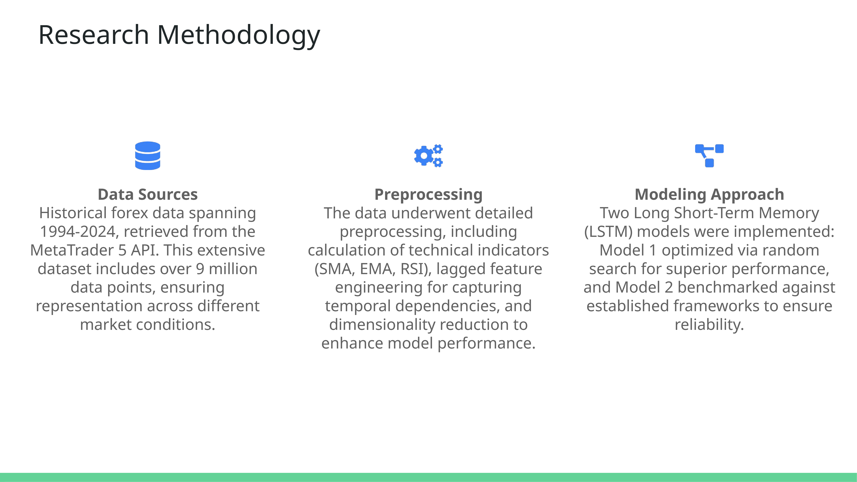

Slide 4
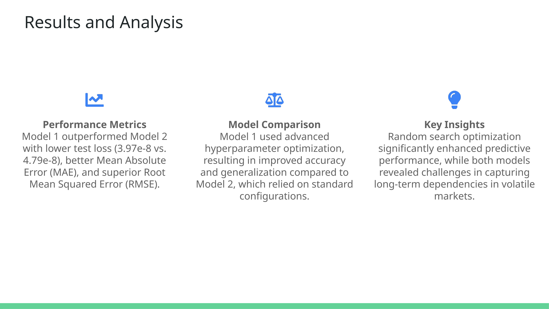
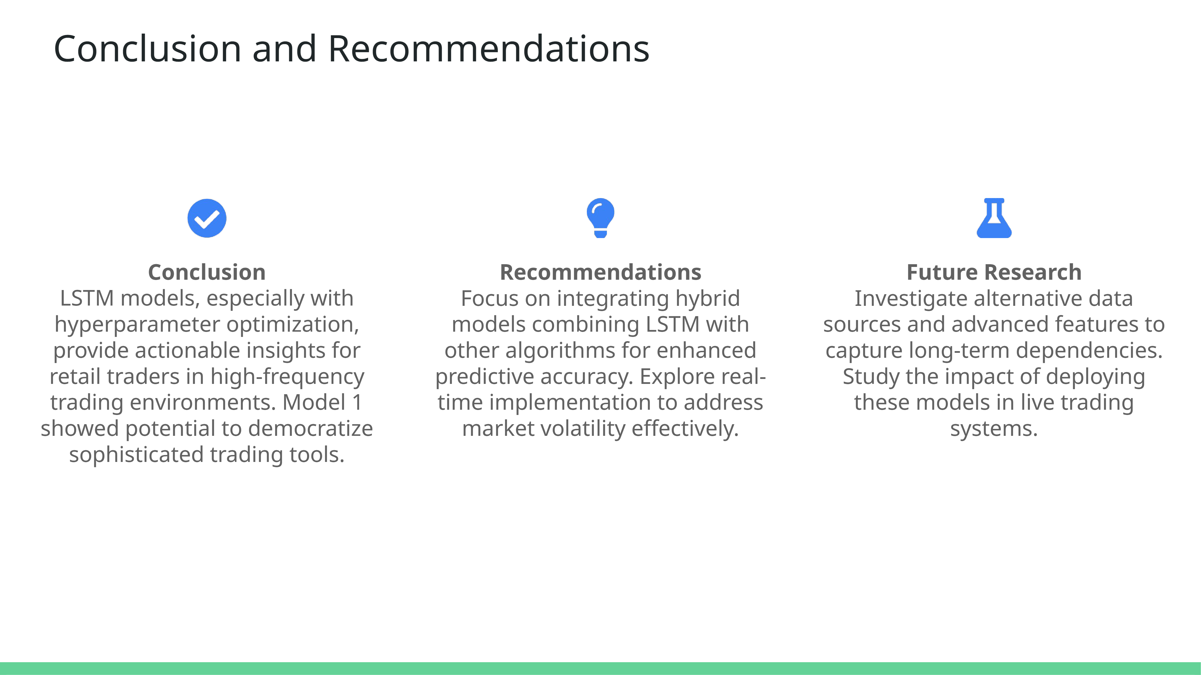

Slide 5
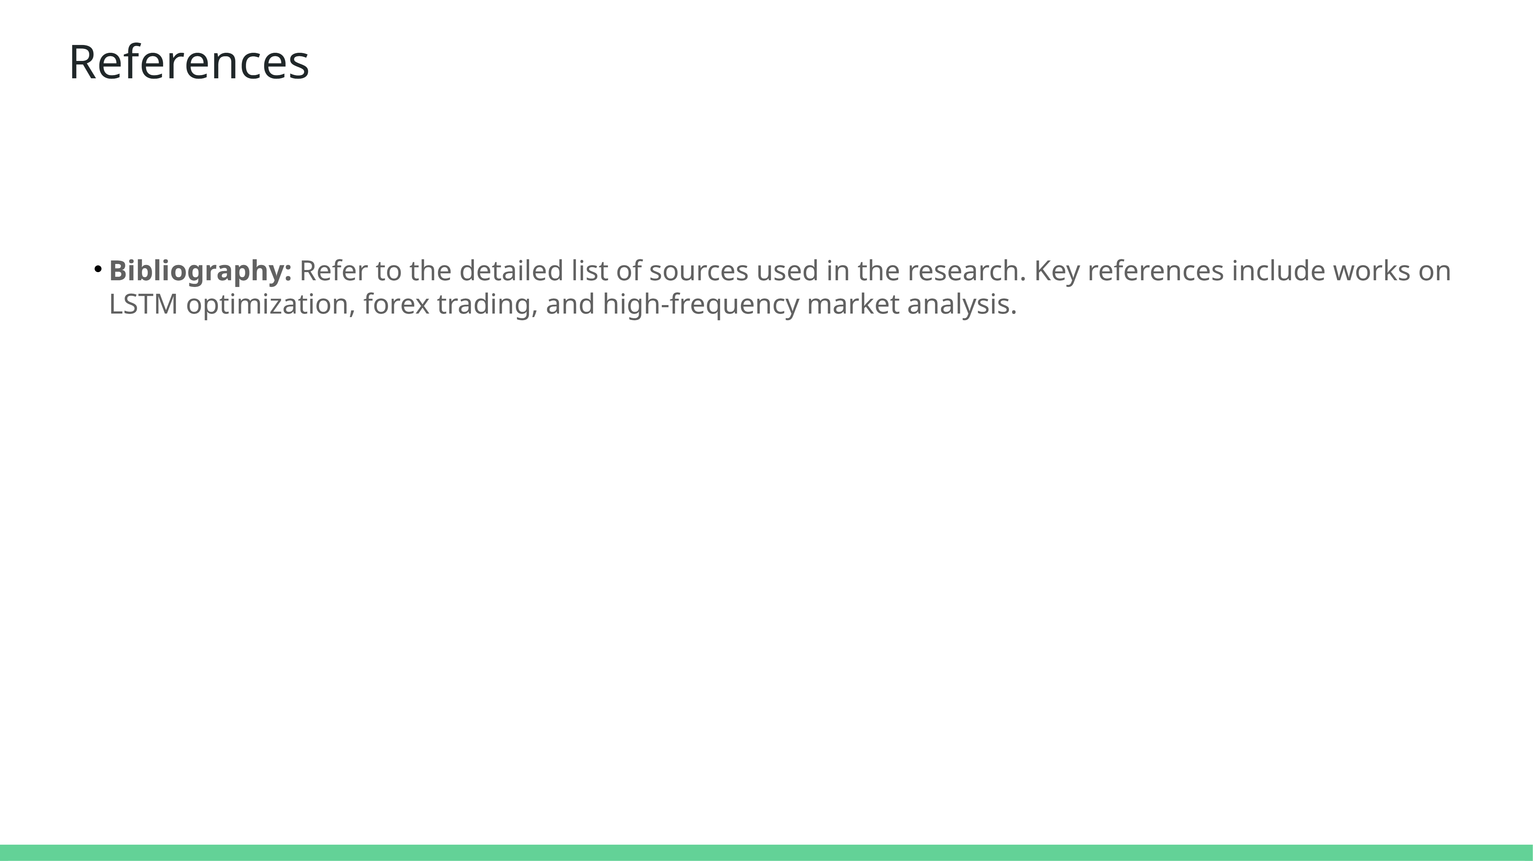

Slide 7
References
[1] Samir Abrol et al. “High frequency trading and US stock market microstructure:
a study of interactions between complexities, risks and strategies residing
in US equity market microstructure”. In: Financial Markets, Institutions &
Instruments 25.2 (2016), pp. 107–165.
[2] Irene Aldridge. High-frequency trading: a practical guide to algorithmic strategies
and trading systems. Vol. 604. John Wiley & Sons, 2013.
[3] Monira Aloud and Edward Tsang. “Modelling the trading behaviour in highfrequency
markets”. In: 2011 3rd Computer Science and Electronic Engineering
Conference (CEEC). IEEE. 2011, pp. 7–12.
[4] Andrés Arévalo et al. “High-frequency trading strategy based on deep neural
networks”. In: International conference on intelligent computing. Springer. 2016,
pp. 424–436.
[5] Jasmina Arifovic, Xue-zhong He, and LijianWei. “Machine learning and speed
in high-frequency trading”. In: Journal of Economic Dynamics and Control 139
(2022), p. 104438.
[6] Michael Ayitey Junior et al. “Forex market forecasting using machine learning:
Systematic Literature Review and meta-analysis”. In: Journal of Big Data
10.1 (2023), p. 9.
[7] Svetlana Bryzgalova, Anna Pavlova, and Taisiya Sikorskaya. “Retail trading
in options and the rise of the big three wholesalers”. In: The Journal of Finance
78.6 (2023), pp. 3465–3514.
[8] GregoryWEaton et al. “Zero-commission individual investors, high frequency
traders, and stock market quality”. In: High Frequency Traders, and Stock Market
Quality (January 2021) (2021).
47
[9] Marinela Adriana Finta, Bart Frijns, and Alireza Tourani-Rad. “Contemporaneous
spillover effects between the US and the UK equity markets”. In:
Financial Review 52.1 (2017), pp. 145–166.
[10] Thomas Fischer and Christopher Krauss. “Deep learning with long shortterm
memory networks for financial market predictions”. In: European journal
of operational research 270.2 (2018), pp. 654–669.
[11] Andreas Gabler et al. “Pattern learning via artificial neural networks for financial
market predictions”. In: Available at SSRN 3243479 (2018).
[12] Kirtika Gupta et al. “Prediction of Stock Prices (A Machine Learning Approach)”.
In: (2021).

Slide 8
[13] Velibor Ili´c and Vladimir Brtka. Evaluation of algorithmic strategies for trading
on foreign exchange market. 2018.
[14] Abdalla Kablan andWing Lon Ng. “Intraday high-frequency FX trading with
adaptive neuro-fuzzy inference systems”. In: International Journal of Financial
Markets and Derivatives 2.1-2 (2011), pp. 68–87.
[15] Robert A Korajczyk and Dermot Murphy. “High-frequency market making
to large institutional trades”. In: The Review of Financial Studies 32.3 (2019),
pp. 1034–1067.
[16] Daniel Ladley. “The high frequency trade off between speed and sophistication”.
In: Journal of Economic Dynamics and Control 116 (2020), p. 103912.
[17] Shengnan Li, Edward PK Tsang, and John O’Hara. “Measuring relative volatility
in high-frequency data under the directional change approach”. In: Intelligent
Systems in Accounting, Finance and Management 29.2 (2022), pp. 86–102.
[18] L Marudulu. “Portfolio optimisation approaches towards investment in the
forex market”. PhD thesis. North-West University (South Africa), 2020.
[19] Imad Moosa. “The regulation of high-frequency trading: A pragmatic view”.
In: Journal of Banking Regulation 16 (2015), pp. 72–88.
[20] Peer Nagy, Jan-Peter Calliess, and Stefan Zohren. “Asynchronous Deep Double
Dueling Q-learning for trading-signal execution in limit order book markets”.
In: Frontiers in Artificial Intelligence 6 (2023), p. 1151003.
48
[21] Mattia Pasqual. “High Frequency Trading: an analysis of the phenomenon
and the effect of the human component”. In: (2020).
[22] ERIK PAULSON et al. “Trading, Investment and Portfolio Management”.
PhD thesis. WORCESTER POLYTECHNIC INSTITUTE, 2017.
[23] Yuan-Long Peng andWei-Po Lee. “Data selection to avoid overfitting for foreign
exchange intraday trading with machine learning”. In: Applied Soft Computing
108 (2021), p. 107461.
[24] George Rayment and Michael Kampouridis. “High Frequency Trading with
Deep Reinforcement Learning Agents Under a Directional Changes Sampling
Framework”. In: 2023 IEEE Symposium Series on Computational Intelligence (SSCI).
IEEE. 2023, pp. 387–394.
[25] Au Vo and Christopher Yost-Bremm. “A high-frequency algorithmic trading
strategy for cryptocurrency”. In: Journal of Computer Information Systems
(2018).
[26] Xuewei Xiang andWeidongWang. “Predicting Intraday Trading Direction of
CSI 300 Based on TCN Model”. In: 2023 2nd International Conference on Machine
Learning, Cloud Computing and Intelligent Mining (MLCCIM). IEEE. 2023,
pp. 293–299.
[27] Ailun Ye et al. “Developing sustainable trading strategies using directional
changes with high frequency data”. In: 2017 IEEE international conference on
big data (Big Data). IEEE. 2017, pp. 4265–4271.
[28] Khairul Zharif Zaharudin. “A SURVEY OF LITERATUREONHIGH-FREQUENCY
TRADING”. In: ().

